Slide 1

Patterns of Effective Test Setup
Seth Petry-Johnson
@spetryjohnson
Notes:
Welcome to Patterns of Effective Test Setup!
This talk is about writing tests.

Slide 2
Notes:
My assertion, if you’ll pardon the pun, is that your tests suck.
Or, less insultingly, your tests suck up your TIME, employer’s MONEY, joy out of doing TDD, and generally make your life more unpleasant than it needs to be.
They do that because you’re making a couple of very costly mistakes when you set up or arrange your tests. You may not even recognize them as mistakes, but they’re causing you pain regardless.
Not your fault, though; lots of really smart people have written articles and books about how to write testable code and how to use TDD. But even if you were doing everything right, I assert that you could still be making those mistakes.
And that’s because many programmers tend to overlook “test setup” and test data as critical areas for innovation and improvement.

Slide 3
That’s OK. I can help!
Notes:
But that’s OK, I can help.
The reason I can help is I’ve spent a lot of time defining test setup patterns for my own team. I’ve made all of the mistakes you’re making. I’ve felt all the pain. And I think I have a solution that makes it better.
The reason I have this solution is the project I manage has been under CONSTANT ACTIVE DEV for almost 8 years. Complexity of code base & size of object model has grown enormously. As result we struggled w/ increasing costs to write tests. Larger our object model got, the harder and more costly it was just to set up the test data for our tests.
In fact, if we’d continued making those mistakes, instead of developing these new techniques, I don’t think we’d still be writing tests today. It would have become financially unbearable.
MY GOAL TODAY is to open your eyes and give you a fresh perspective on your own tests. I want you to recognize the mistakes you’re making, I want you to be inspired to raise the bar and do better, and I want you to know how to begin when you get back to the office on Monday.

Slide 4
Are you in the right place?
Not "testing 101"
Notes:
Before I get into the good stuff, I want to set some quick expectations about this session.
First, this is not a Testing 101 session. I assume that you’re familiar with at least the basics of writing tests.

Slide 5
Are you in the right place?
Not "testing 101"
Not about mocking / stubbing
Notes:
Second, this isn’t about mocking or stubbing.
Generally speaking I would consider those topics part of “setup”, but that’s a whole different talk and is out of scope for today.

Slide 6
Are you in the right place?
Not "testing 101"
Not about mocking / stubbing
Not about specific framework or language
Notes:
Third, I’m not trying to sell you a specific language, library, or framework. This is a talk about ideas and patterns. The slides are going to show you those ideas in C# and NUnit, but the concepts can be applied in many different platforms.

Slide 7
Are you in the right place?
Not "testing 101"
Not about mocking / stubbing
Not about specific framework or language
All about improving test setup
Notes:
Today, I’m going to focus entirely on improving the ways that you arrange test data and prepare your system to execute a test. That’s it.

Slide 8
Why is test setup so important?
Notes:
So why is test setup so important? It makes up the majority of your test code.
Assuming you’re not doing anything bizarre in your tests, they likely all follow the same pattern: do a bunch of stuff to get ready, then call the one method or function that you’re testing and end w/ assertion or two.
Bulk of the code is the setup, and the quality of that code is a huge factor in how effectively you can leverage tests towards your ultimate goals.
And if you’re setting up your tests poorly, it’s gonna cost you. To help illustrate that, I have a short story about why I’m here and where these ideas came from.
Click for dupe slide & story

Slide 9
Why is test setup so important?
Notes:
Begins 8 years ago when just joined my current employer. Starting a new project / going to be FIRST PROJECT in which that team had ever written automated tests.
Starts out great, everyone’s writing tests / shipping features / going good. But a year or so later, after the code had started to get MORE COMPLEX and we’d started revisiting features to add new functionality, I began to feel something was wrong. AT THIS POINT I’d really shotgunned the Agile kool-aid & was expecting transformational impact from testing, but it didn’t feel like we were living in the land of unicorns and happiness. Something was missing.
As I investigated, I noticed that despite our commitment to testing, many key objects DIDN'T HAVE MANY TESTS. It turns out that as the code was getting more and more complex, it was getting harder and harder to set up the tests. This team was new to testing, they didn’t know how to deal with that, and so they’d begun AVOIDING TESTS for the more complex stuff. And unfortunately, that was the stuff that really needed tests the most.
When they couldn’t avoid the tests, they ended up writing some PRETTY GNARLY setup code. In one particular case I needed to make a minor adjustment to a feature. The feature itself was complex, but the new change was relatively simple and I didn’t think it would take much time. Before writing any new code, however, I wanted to learn more about how the feature currently worked and I wanted to write a failing test. So I opened up the file containing the tests and my heart sank when I saw this:

Slide 10
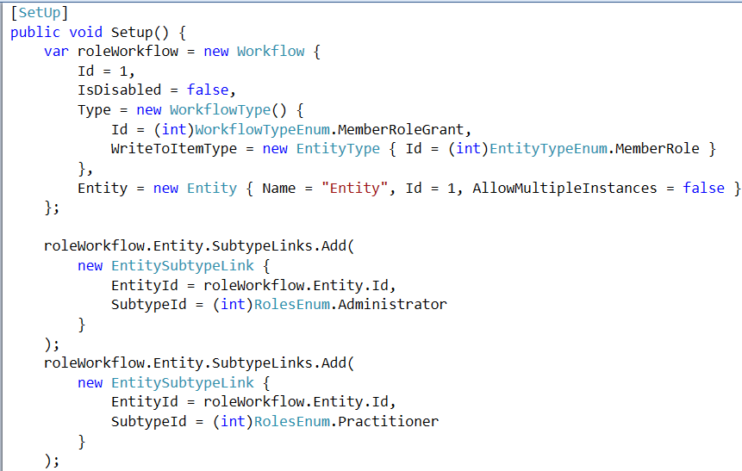
Behold, the reason we’re here
Notes:
(pause, then continue)

Slide 11
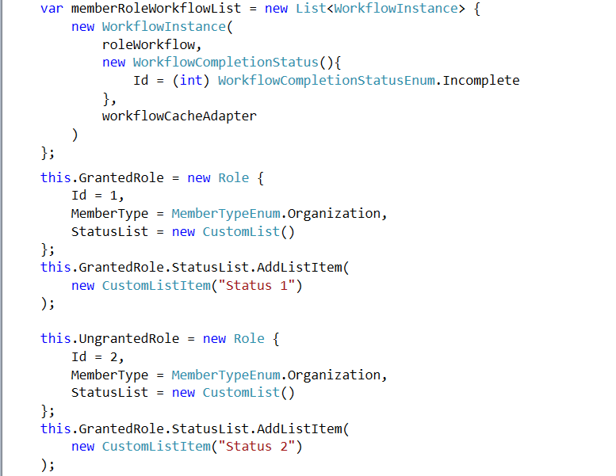
Notes:
... And this …

Slide 12
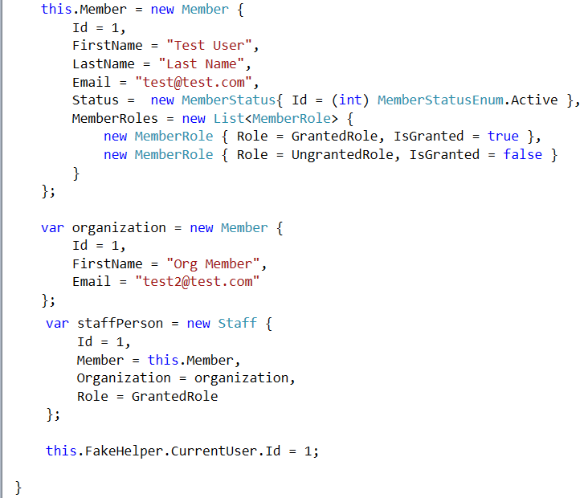
Notes:
… and this.

Slide 13
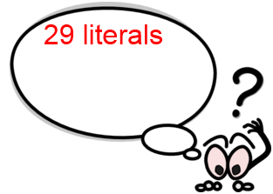
Notes:
That’s 29 string, integer and Boolean values being initialized….

Slide 14
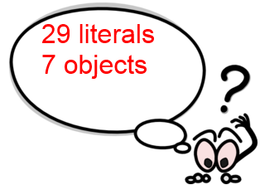
Notes:
… 7 objects being created…

Slide 15
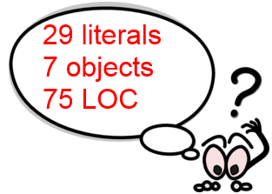
Notes:
… and 75 lines of code to understand.

Slide 16
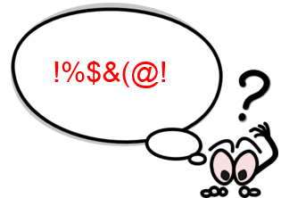
Notes:
This is just the SHARED setup code for the test suite. Individual tests had more code like this, and all depended on different portions of this mess.
Became clear that even though my change was simple, understanding and modifying tests would not be
Went back to team – increased estimate – spent more time than should have been necessary
Not an isolated case – thousands of tests in our projects
Countless hours spent reading those tests and trying to make sense of stuff like this
TRANSITION: This sucks. Fortunately, it doesn’t have to be this way.

Slide 17
What’s on the agenda?
What it means to be "effective"
Mistakes you're making today
Key patterns to follow instead
Super easy integration tests!
Notes:
Today we’re going to talk about what it means to have effective test setup patterns,
we’re going to look at the mistakes you’re making today that reduce the effectiveness of your setup code,
and then I’ll show you a number of patterns and techniques to do instead.
We’ll finish by looking at ways for applying these same patterns and techniques to integration tests as well as unit tests.

Slide 18
What is "test setup"?
What is "effective test setup"?
Notes:
But, let’s walk before we run. The first thing we need to do is answer these two questions. What do I mean by “test setup”, and how do we know if it’s being done effectively?

Slide 19
What is "test setup"?
Anything you do to create baseline "input" for a test
What is "effective test setup"?
Notes:
By “test setup”, I mean anything that you do to create the baseline “input” for a test. This could mean creating OBJ IN MEMORY.
It could mean putting DATA INTO DB. It could mean putting FILES ON DISK.
Could also mean setup code that’s SHARED between multiple tests or it could be setup code that’s unique to a specific test.
In general, I would include mocking and stubbing as “test setup”, but I’m focusing mostly on test data today.

Slide 20
What is "test setup"?
Anything you do to create baseline "input" for a test
What is "effective test setup"?
The art of writing clean, expressive setup code that doesn't suck
Notes:
When I say effective test setup, I’m referring to the art of writing clean, expressive setup that doesn’t suck.

Slide 21
What is "test setup"?
Anything you do to create baseline "input" for a test
What is "effective test setup"?
Coding patterns that increase the value of tests
Notes:
Or, more precisely, I’m referring to coding patterns that increase the value that automated testing provides to your project
How do you identify effective test setup patterns? A project with effective patterns looks something like this:

Slide 22
Signs of effective test setup
Tests so easy to write, you write lots of them
Notes:
First, tests are so easy to write, that you write a metric crapton of them.
Something really enjoyable about getting into that TDD rhythm of red-green-refactor, but can only do that if tests are painless to author. And if tests are painless to author, then either your code is simple or you’ve deliberately made them painless to author.

Slide 23
Signs of effective test setup
Tests so easy to write, you write lots of them
Tests often fit on 1 screen of code
Notes:
Second, it’s a good sign if all of your tests are short and sweet.
Rough rule of thumb is that the entire test should fit on ONE SCREEN at one time. If your tests routinely require 2 or 3 screenfuls of code then my guess is that they are not easy to write, they’re probably not easy to read, and you probably aren’t writing a ton of them.

Slide 24
Signs of effective test setup
Tests so easy to write, you write lots of them
Tests often fit on 1 screen of code
Tests require minimal maintenance over time
Notes:
Third, effective setup means that your tests don’t need a lot of refactoring or maintenance over time. Tests things are far less valuable if we’re constantly messing with them, and good setup habits can lead to more resilient tests.

Slide 25
Signs of effective test setup
Tests so easy to write, you write lots of them
Tests often fit on 1 screen of code
Tests require minimal maintenance over time
Integration tests as easy to set up as unit tests
Notes:
Lastly, a huge sign that you’re doing it right is that you can write integration tests that hit a real database or a real filesystem just as easily as you write in-memory unit tests. This is huge. This is the promised land. This is what I want to show you today.
Now, if I just described your project, then you’re probably in the wrong room because you’re already living in that promised land. However, I’m guessing many of you are here because your projects show signs of ineffective test setup.

Slide 26
Signs of ineffective test setup
Testing isn't fun / too costly
Notes:
The first sign of ineffective setup is that it’s too hard or frustrating or time consuming to do frequently. If testing isn’t fun, if you avoid writing tests because it sucks to do, maybe you’re doing it wrong.

Slide 27
Signs of ineffective test setup
Testing isn't fun / too costly
High WTF-to-test ratio
Notes:
Another bad sign is if you curse in disgust every time you read or maintain an existing test. When I opened that original test I showed you a minute ago, I cursed like a sailor. I could tell instantly it was going to be a nightmare, and it was.

Slide 28
Signs of ineffective test setup
Testing isn't fun / too costly
High WTF-to-test ratio
Easiest way to "fix" tests is with <DEL> key
Notes:
A third sign of ineffective setup patterns is that tests frequently break, but it’s way easier to delete them then figure out how to fix them.
You ever do this? You’ve got a red dot on your screen, but you have no freakin’ clue what the test is doing, so you look over your shoulder, everyone’s at lunch, so you Ctrl-A, delete, Ctrl-S, git push commit. Boom. Fixed.
Yeah, that’s a sign that your tests need some work.

Slide 29
Signs of ineffective test setup
Testing isn't fun / too costly
High WTF-to-test ratio
Easiest way to "fix" tests is with <DEL> key
Integration tests? LOL!
Notes:
And lastly, if your unit tests are painful to write or maintain, I’m guessing you don’t have a lot of integration tests. And if you don’t have integration tests, then you’re really missing out on some real-world feedback about how your system really works.
If any of these things sound familiar, then you’ve got some work to do.
To help you with that, I’ve identified 4 mistakes that you might be making that make your tests so ineffective.

Slide 30
Test Setup Mistake #1 Manually constructing test data
Notes:
The first mistake people make when setting up tests is constructing all of your object dependencies by hand.
In almost every system there are tests that only care about a portion of an object. A test about an Order’s SHIPPING STATUS may not care about its line items, or a test about a Customer’s ADDRESS may not care about their name.
Not always possible to create objects and specify ONLY what you care about. In C# for example the object’s constructor may require things that are necessary to the domain model, but don’t actually matter to that specific test

Slide 31
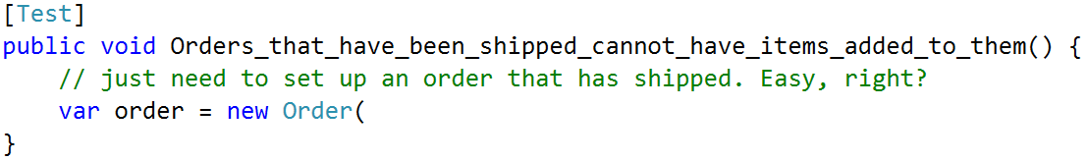
Mistake #1: Manually constructing objects
Notes:
For example, in this test, all I need is a shipped Order.

Slide 32
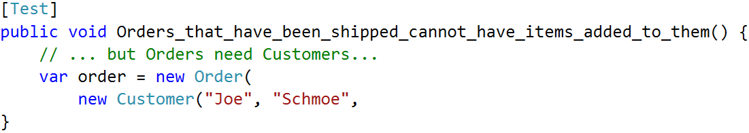
Mistake #1: Manually constructing objects
Notes:
But apparently an Order object needs a Customer…

Slide 33
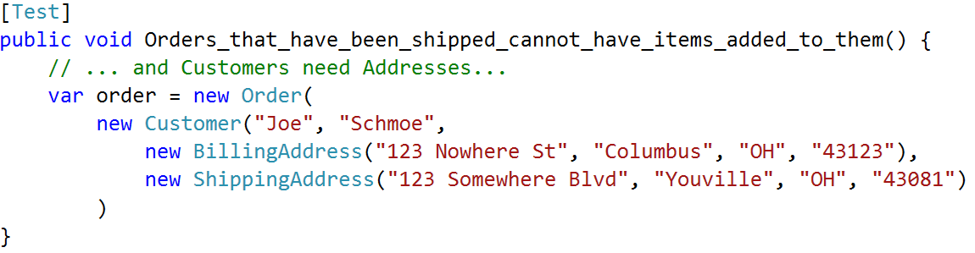
Mistake #1: Manually constructing objects
Notes:
… and a Customer needs some Addressess…

Slide 34
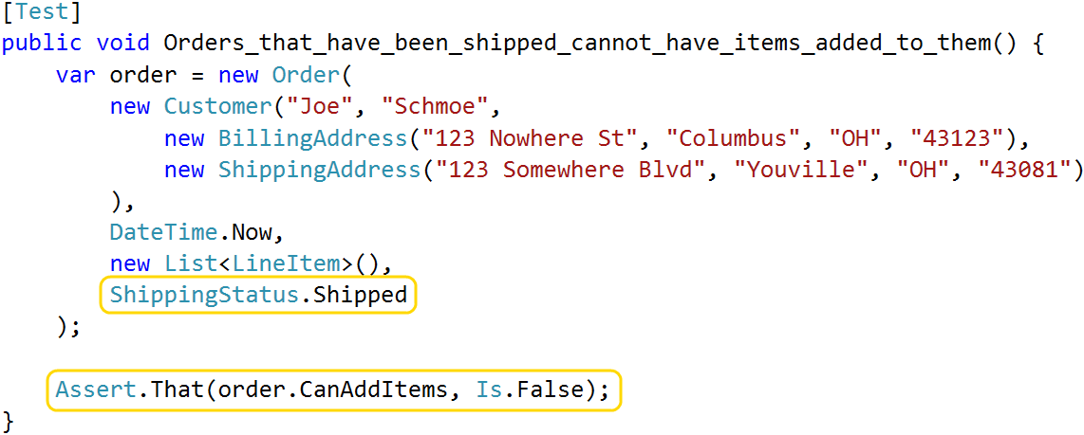
Mistake #1: Manually constructing objects
Notes:
… and by the time I’ve satisfied the constructor, I’ve written a whole lot of code when I really only care about two things: the order’s shipping status, and whether or not it accepts new items.

Slide 35
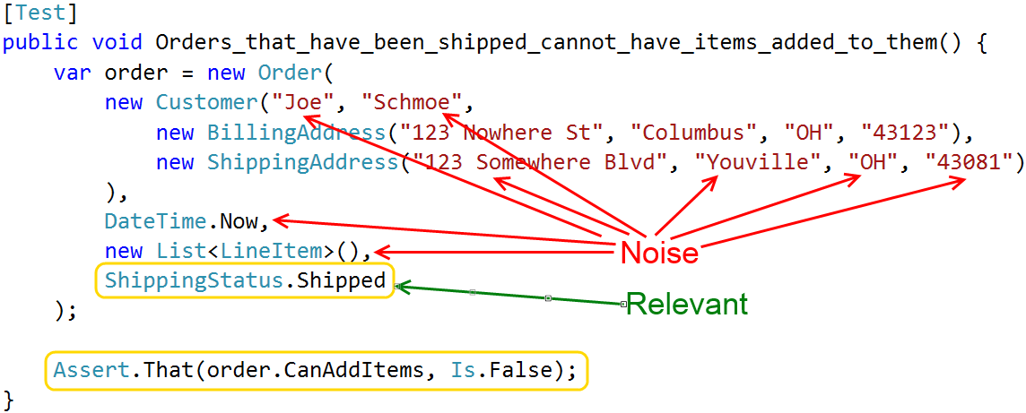
Mistake #1: Manually constructing objects
Notes:
All of these things that I created, but that don’t actually influence the assertion I’m making, are noise. They make your tests way harder to write than they need to be.

Slide 36
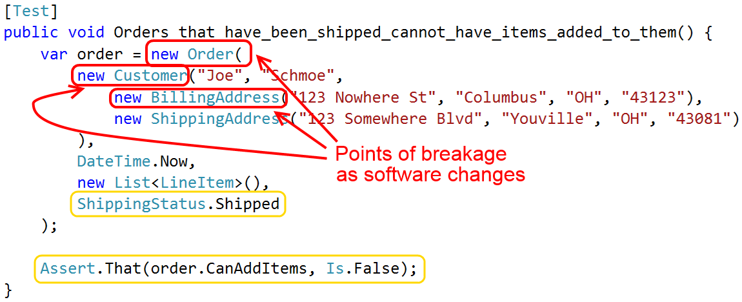
Mistake #1: Manually constructing objects
Notes:
This mistake can also make your test code brittle.
What happens when the Order, Customer or Address constructors get modified?
If you’ve ever made a simple change to your application, and then spent the next two hours cleaning up failing tests, you’ve felt this pain.

Slide 37
Test Setup Mistake #2 Setup code is hard to read & understand
Notes:
That first mistake makes test hard to write. The second mistake is writing tests that are hard to read and understand.
One thing that makes setup code hard to understand is when there’s too much of it. That first test I showed you is an example of this; if you routinely write tests with 75 lines of dense setup code, then you’re probably doing something wrong.
Another example of setup that is hard to understand is when you create test data using explicit values, but those values don’t actually impact the outcome of the test.

Slide 38
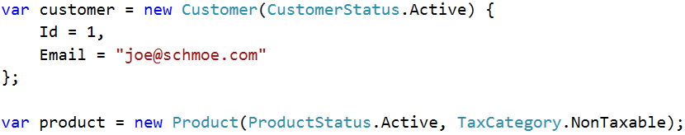
Mistake #2: Setup is hard to understand
Notes:
Consider this example. The Customer and Product constructors both require certain values. And in addition, let’s assume that the test we’re going to run will execute code that throws an error if the customer ID or email address are left at their default values of 0 and null.

Slide 39
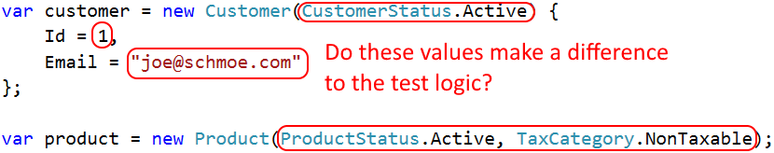
Mistake #2: Setup is hard to understand
Notes:
The problem is, when you set up this test, you have to specify those values even if they DO NOT MATTER to the test outcome.
When other programmers read that code, they have to spend time figuring out which values are significant and which are arbitrary. Are we testing a business rule that cares if the product is taxable or not?
And if this code is shared by multiple tests, it can be hard for someone to figure out which values they can modify to fit their needs and which values are significant to existing tests.

Slide 40
Test Setup Mistake #3 Reusing setup code via inheritance
Notes:
The third mistake I see in setup code is using inheritance as a way of sharing logic between multiple tests.
I often find that there’s a certain amount of boilerplate setup that’s useful across multiple fixtures. For instance, you might create an Order, a Customer, and a few Line Items and link them all together in a meaningful way. This arrangement could be useful when testing any of those objects or any number of related business features, so naturally we’d want to make that setup logic reusable.

Slide 41
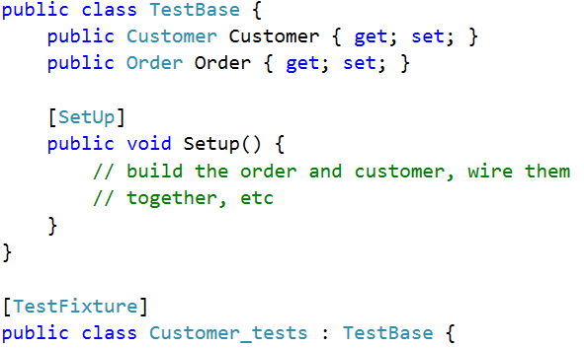
Mistake #3: Using inheritance for reuse
Notes:
A quick and easy way of doing that would be to create a base class and do the setup there, like you see here. You’d expose the things you want to share as instance properties.
Every class that needs that shared data could derive from that base class and get access to the data.
There are two problems with this. First, inheritance is a very restrictive way of achieving reuse. In C# you can only have a single base class, and there’s just no good argument for requiring that your Customer tests and your Order tests derive from the same base.

Slide 42
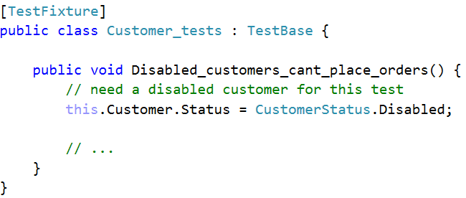
Mistake #3: Using inheritance for reuse
Notes:
Secondly, as your system evolves over time, the needs of your tests might start to diverge. Maybe there’s one specific Customer test that needs to specify a distinct email address, or an Order test that requires that the Order not have any line items.
If the setup code is in the base class, you end up doing things like initializing data in the shared area, and then overriding parts of it in the body of each test.

Slide 43
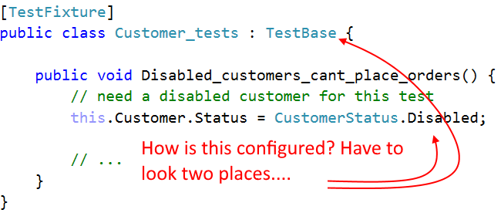
Mistake #3: Using inheritance for reuse
Notes:
This just doesn’t scale over time. It’s confusing to read and maintain because you’ve taken this single logical thing, the instantiation of your test context, and you’ve split it across multiple files. And if anyone ever changes the shared data, your test might break until you add another override.
To properly reuse setup logic we need to get it out of a base class and into something more easily managed. I’ll show you what that looks like in a moment.

Slide 44
Test Setup Mistake #4 Assuming external systems are in a specific state
Notes:
The final mistake I see people making is writing integration tests that make assumptions about the state of external systems. This might mean assuming that a file exists in a specific location, or assuming that specific data will exist in the database.
Every assumption that you make about the state of an external system makes your tests more brittle.

Slide 45
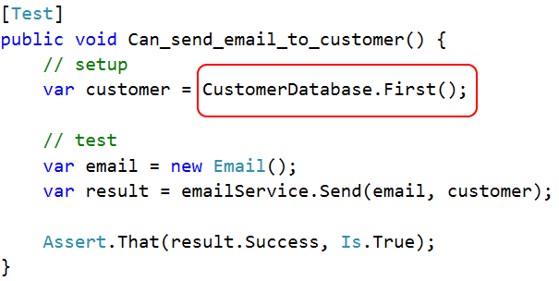
Mistake #4: Assuming data exists already
Notes:
Even something as simple as this can be a problem. This test needs a Customer, so it just grabs the first one in the database.
But what if you’re running against an empty database? Or what if this email service is designed to reject customers that have a known bad email address? Maybe on your database this pulls back a normal customer and the test passes, but on a coworker’s machine it pulls back someone in a flagged state and fails.

Slide 46
There is a better way!
Notes:
So how do we avoid those mistakes and write tests that don’t suck up all our time, money and energy?
I’ve identified 4 key practices that you can implement to avoid each of those mistakes.

Slide 47
Key Practice #1 Stop creating data by hand!
Notes:
The first key to success, and the single most important thing you can do to improve your setup code, is to stop constructing test objects by hand. Instead, push object creation into some sort of helper method or object.
This gives you two benefits:
SHORTENS your setup code, making it easier to write and read
INCREASES resiliency; if an object’s constructor changes, you potentially only need to update the helper method.
Here’s an example of why this matters.
In my app, one of our core domain concepts is a thing called a “workflow”. There are very few things that a user can do that don’t involve a workflow in one way or another, which means that many of our requirements deal with workflows in different states.

Slide 48
Key #1: Stop creating data by hand!
"When a Workflow is <configuration> then the system should <behavior>"
Notes:
As a result, many of our requirements look like this: “When a workflow is <configured like this> then the system <should do that>”.
In practice, though, actually creating a workflow in that state is complex; a workflow is composed of lots of smaller objects that work together, and they all have to be set up in a logically consistent way to represent real-world code paths and to avoid runtime errors.

Slide 49
Key #1: Stop creating data by hand!
"When a Workflow is <configuration> then the system should <behavior>"
75 lines of code / 6 objects / 29 literal values
Notes:
When we have to create those objects by hand, we end up with the mess I showed you at the start. And since we deal with these objects all the time, anything we can do to make this type of setup faster pays huge dividends.
There are a couple of well-known patterns for handling object creation.

Slide 50
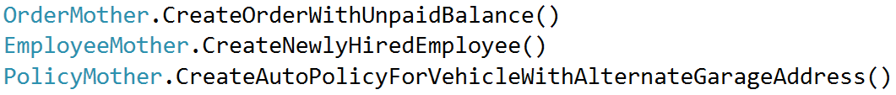
Key #1: Stop creating data by hand!
Object Mother
Notes:
First pattern we tried is called Object Mother. The key idea behind this pattern is that you identify UP FRONT the different test data that you’ll need, and then you create static factory methods for each of those pre-defined states. For example, the “Order Mother” object might have a factory method for creating an order with an unpaid balance, or if you work with insurance, the “Policy Mother” object might create an insurance policy object with a specific combination of coverages.
Object Mother is a great way to get those noise values out of your setup code, but it DOESN'T SCALE. As software gets more complex you’ll need more pre-built objects in more and more pre-defined states.
As the number of pre-built objects and states grows it becomes harder to maintain them and harder for developers to choose between them.

Slide 51
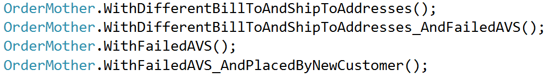
Key #1: Stop creating data by hand!
Object Mother
Notes:
Eventually, you end up with a mess like this. There’s one method for creating an order with different bill-to and ship-to addresses. There’s one for indicating that the credit card failed address verification. There’s one for specifying that the order was placed by a new customer.
There’s a ton of overlap here. What happens when someone needs an order that was placed by a new customer, and had failed the AVS checks, and had different bill-to and ship-to addresses? That exact scenario isn’t covered by any of these, so that developer would probably end up creating yet another method for their exact need. And that new method would probably have a lot of duplication when compared against the ones that already exist.
Object Mother is an EASY PATTERN if you only need a couple of course-grained pre-built objects. We needed a lot more control over our test data, so we quickly outgrew this pattern.

Slide 52
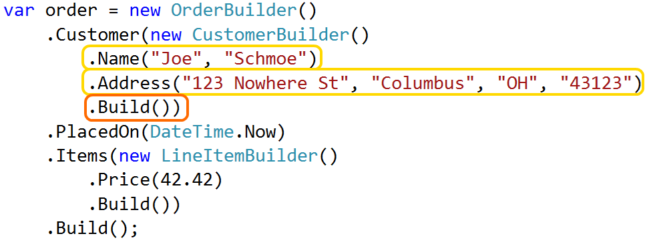
Key #1: Stop creating data by hand!
Data Builder
Notes:
Next thing we tried was a pattern called Data Builder.
Rather than a factory, Data Builder lets you create customized objects in the body of each test. It’s common for this to be accomplished via a Fluent API that exposes the things that can be customized.
The general structure in this pattern is that initialize the builder itself and then start calling methods to customize various parts of the object. Those methods are chained together and at the very end you call a Build() method which returns your fully built object.
These can be very simple, or they can get pretty complex as you see here where we’re creating both an Order and Customer with customized properties.
MAIN BENEFIT IS FLEXIBILITY b/c lets you create PRECISE DATA that you need for each test, and that makes it a much better fit for larger or more complex applications.

Slide 53
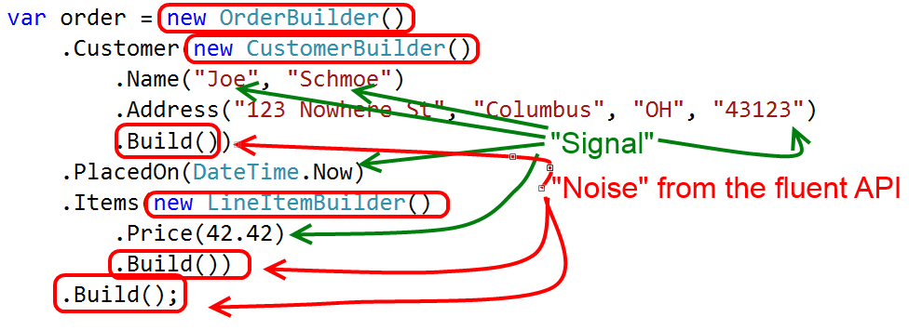
Key #1: Stop creating data by hand!
Data Builder
Notes:
However, I’m really not a big fan of the Fluent API. It’s verbose and adds a lot of noise, as you see here. The green arrows are pointing to the significant data that I’m creating and the red circles are basically the “noise” that we get from the fluent API.
All this noise code means that the setup code is harder to write, read, and maintain. And on top of that, actually implementing the Fluent API is tedious. It requires a lot of boilerplate code that in my experience just isn’t worth the hassle.

Slide 54
Key #1: Stop creating data by hand!
Test Helper
(Static Methods) + (Customization) – (Fluent API)
Notes:
Eventually, we created a hybrid of these two patterns that combines the static factory class of Object Mother with the customizable nature of a Data Builder, minus the Fluent API.
We call this the Test Helper pattern. It’s a terrible name, but it’s been a really useful pattern for us and I think it’s highly applicable not only in C# but also in JavaScript or Ruby.

Slide 55
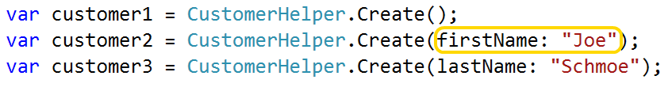
Key #1: Stop creating data by hand!
Test Helper
Notes:
The first step in implementing a Test Helper is to create a static factory class, one for each type of object you want to build. I generally name them like this: FooHelper creates a Foo.
That factory gets a single static method called “Create”, which allows the caller to customize the object via METHOD ARGUMENTS.
The idea is that the caller should only specify those values that they care about, and omit the rest.

Slide 56
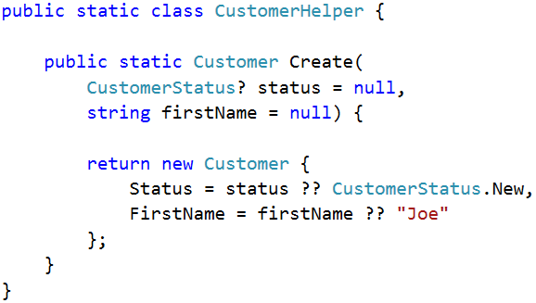
Key #1: Stop creating data by hand!
Assign meaningful defaults
Notes:
The helper’s job is to build the object, filling in the gaps between what the caller specified with meaningful defaults.
I generally declare arguments with a null default in the method signature, and then when I'm constructing the object I use the null coalescing operator to provide a real value.
You could assign the default value directly in the signature, but that only works with primitive types.
(transition quickly)

Slide 57
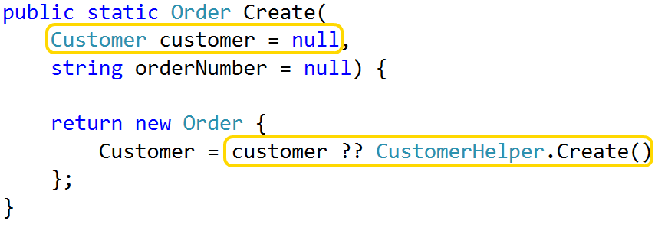
Key #1: Stop creating data by hand!
Delegate to other helpers as needed
Notes:
Sometimes you'll want to pass in complex objects, such as specifying which Customer to use with an Order. You can't assign a default value for those types within the signature, so I generally just declare everything as null up here and provide all the real defaults down here, for consistency's sake.
Also, it's important that if you need to create other objects, always delegate to another helper to create them. Each helper should only know how to construct a single type. This keeps both your tests and your helper code clean and tidy.

Slide 58
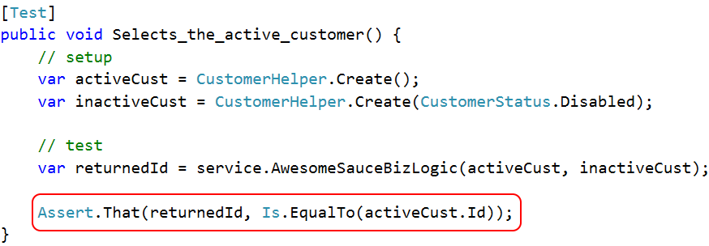
Key #1: Stop creating data by hand!
Avoid "unexpected equality"
Notes:
When assigning default values, there’s one potential gotcha. I call this the problem of “unexpected equality”.
Let’s say you create two different Customers from the helper, pass them into some method that performs a comparison, and that method returns the Customer ID matching some business rule. The tests asserts the return value is equal to the ID of customer #1.
The assumption encoded here is that the test should fail if the code returns the ID of customer #2. But if the CustomerHelper object creates Customers with a default ID value of 0, or some other hardcoded static value, both Customers will be created w/ same ID. Test will pass even if the code is broken. This is what I mean by “unexpected equality”; if I create two separate objects, I don’t expect them to be considered equal.
So, by default, I prefer to make all significant values unique. This applies to IDs, names, email addresses, etc. I want programmers to intentionally be explicit if they want things to be equal.

Slide 59
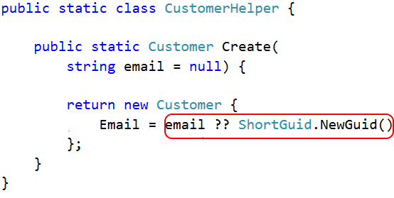
Key #1: Stop creating data by hand!
Avoid "unexpected equality": ShortGuid
bit.ly/1dCxSbe
Notes:
To assign unique strings, I use a class called ShortGuid. This is basically a shorter, URL-friendly, base64-encoded GUID. It’s more compact than a standard GUID, which can be helpful in some cases, but it’s still guaranteed to be unique. You can get this code off the web.
Whenever I’m creating a name or a title or something, I use a ShortGuid as the default. It guarantees that no two objects I create will share the same value, unless I explicitly set them up that way.

Slide 60
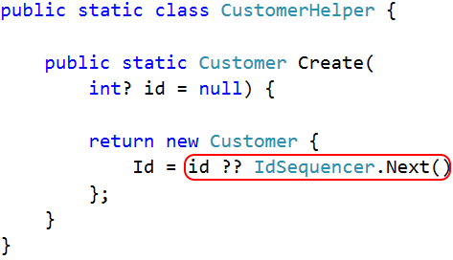
Key #1: Stop creating data by hand!
Avoid "unexpected equality": IdSequencer
bit.ly/1d7zHz7
Notes:
To assign unique integers I created a static class called the IdSequencer. It basically starts a counter and hands out a unique value each time I call “next”. Any time I have a helper that creates something with an ID property, I expose the ID as an argument and then I default it using the sequencer.
You could assign a random number instead, but this sequencer comes in really handy on integration tests. You’ll see that in a few minutes.

Slide 61
Key #1: Stop creating data by hand!
Test Helpers vs 3rd party libraries
Notes:
People often ask me why I write my own Test Helper classes instead of using a 3rd party object construction library.
In .NET there are libraries that take a generic type argument and automagically create an instance of that type, populating it with test data. This particular example is from a library called AutoFixture, and it looks super easy. Why not do this?
The simple answer is that no library that you download can make better decisions about your test data than you can. Early on, when your objects are simple and you don’t have lots of special cases in your system then sure, this might work OK. But as things get complex, you’re going to want control over how your default values and properties get set up, and you don’t get that with a library.
And in addition, these libraries tend to be noisier than custom code.

Slide 62
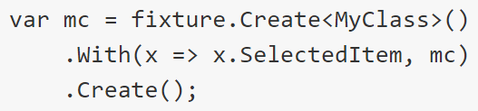
Key #1: Stop creating data by hand!
Test Helpers vs 3rd party libraries
Notes:
Here’s what AutoFixture looks like if you want to specify a value for a property. Sure is a lot simpler to read and write the Test Helper version.
Basically, I look at it like this: when your app is small and simple, then the libraries might work. But if your app is small and simple, then introducing my Test Helper pattern is super easy too. And since Test Helper is designed to deal with complexity, you’ll start out with a solid foundation that will scale right along with your app code. And if your app is already really complex, then these libraries aren’t going to save you as much time as you might think.

Slide 63
Key Practice #2 Tell a story with your test data
Notes:
The second key to success is to make sure that your test setup code, and your test data, tell a story.
Reason is that, at their core, tests are valuable because they HELP US UNDERSTAND our software. To fully deliver that value, they have to effectively convey information when they are read.
You could write the most bassackwards and incoherent tests possible and the computer could still figure out if the assertions hold true. But that won’t help your poor coworker who opens that file a month later and needs to make a change. CPU cycles are cheap, your coworker’s time is not. Investing in clear, concise setup code is key.
When it comes to telling a story, there are a few basic things to keep in mind.

Slide 64
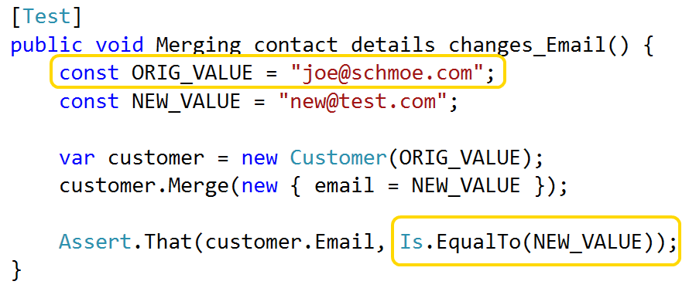
Key #2: Tell a story
Use names to convey meaning
Notes:
First, names matter. If your setup code is a story, then your variable names and values are the actors in that story. Use them to drive home the point of a given test.
In this example, the actual values in use are irrelevant; they are just two arbitrary values that need to be different. By giving those values meaningful names, the assertion more clearly documents the intent behind the test.

Slide 65
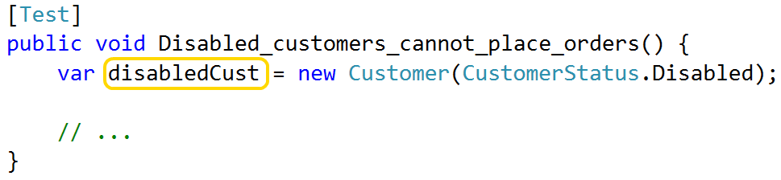
Key #2: Tell a story
Use names to convey meaning
Notes:
Or if your test revolves around the fact that a customer is disabled, don’t just call it “customer” or “c”; call it “disabledCustomer”.

Slide 66
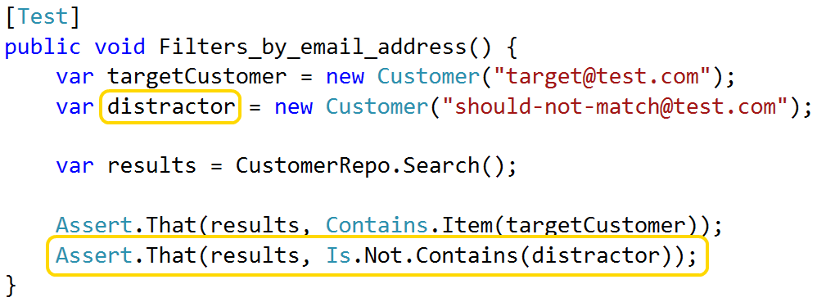
Key #2: Tell a story
Use names to convey meaning
Notes:
If your test contains multiple objects of the same type, differentiate them! It sounds obvious, but I still see smart, experienced developers writing tests with variables called “customer1” and “customer2”. That is a completely unnecessary mistake that reduces the clarity of your setup code.
In this case, I’m testing some search logic. To write a complete test, I need to assert both that the code DOES return a match and DOES NOT return something that doesn’t match.
Naming the objects in this way provides way more meaning than “customer1” and “customer2”. And if you use consistent names across your tests, your coworkers will start to recognize these patterns. If I see the word “distractor” in any of our tests, I know exactly what it’s there for.

Slide 67
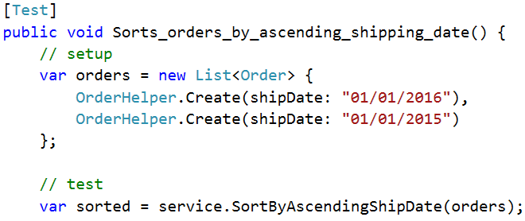
Key #2: Tell a story
Use names to convey meaning
Notes:
Here’s one final example of how good names can convey meaning. This test is asserting that a specific feature returns data ordered in a specific way.
If I create the test data in the same order in which I expect them to come back out, then it’s possible that the sorting code isn’t do anything at all, and the test is passing by coincidence. A better test would be to create the data in a different sequence than it should come out, because then the test will only pass if it’s actually applying some sort logic.
This isn’t terrible, but it’s not telling as clear of a story as it could.

Slide 68
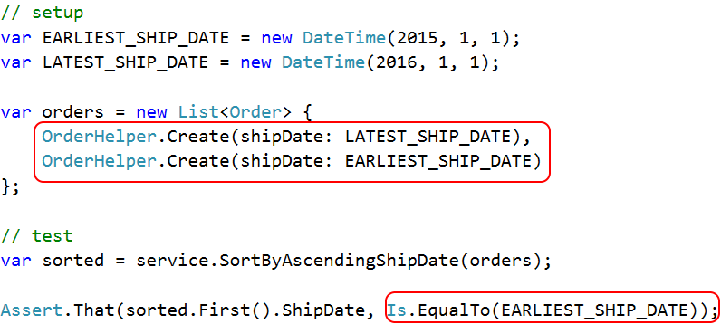
Key #2: Tell a story
Use names to convey meaning
Notes:
Here’s that same test, but where I assign those values names that describe their purpose. And as a result, I’m able to write an assertion that far more explicitly captures my intent behind the test.
On the sorts of tests that fit onto these slides, some of these techniques may not seem that useful. But if you get in the habit of doing this, then you’ll start to see a real difference in the readability of your real-world tests, especially as your setup logic gets larger and more complex.

Slide 69
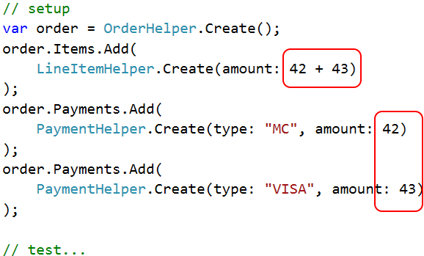
Key #2: Tell a story
Cultivate a clean, concise API
Notes:
Another way to tell a clear story is to use your helper API to write fewer lines of code, but at a higher level of abstraction.
Here’s an example where I’m using a test helper to set up an Order that has two payments associated with it.
Creating this order is a single logical concept, but it requires multiple physical statements to accomplish. Alternatively I could move these instantiations inline, but then I end up with a larger, heavily nested construct that’s harder to read.
Also, in order to make sure that this object is internally consistent, I might have to manually make sure that the order subtotal matches the sum of the two payments.

Slide 70
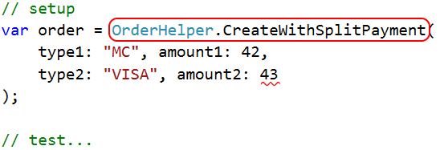
Key #2: Tell a story
Cultivate a clean, concise API
Notes:
By taking a more declarative approach I reduce the amount of code and the test setup becomes simpler and more expressive.
In addition, note that I no longer need to manually specify the order subtotal; the helper can easily infer that value from the sum of the two payment amounts and wire everything up for me.
And once this piece of code is written, it’s available for reuse by other tests that have similar needs.

Slide 71
Key Practice #3 Create "scenarios" for complex setup / reuse
Notes:
The 3rd key practice is to use "scenario" objects to reuse complex setup.
Test Helpers are great at returning single objects. But what if you need of keep track of multiple objects AND their relationships?
For example, if you have an e-commerce site then many of your tests will deal with Orders and Customers. You might find yourself repeating the same setup over and over again: create an Order. Add some items to it. Assign a customer. Etc.
To reuse that logic I use a pattern that we call a Scenario. Scenarios are essentially façades that encapsulate the coordination of multiple Test Helpers. When used correctly, they can dramatically simplify certain types of setup code.

Slide 72
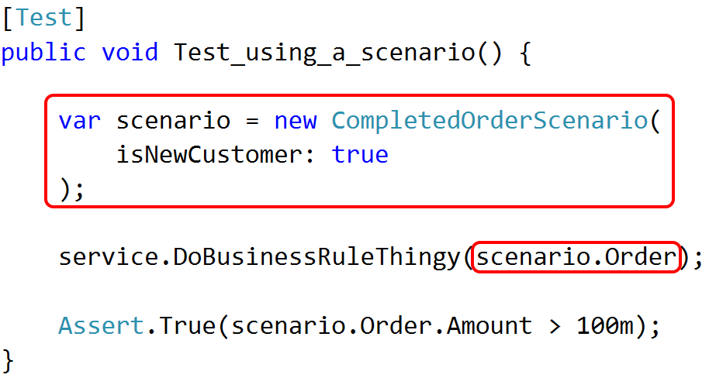
Key #3: Use Scenarios to reuse setup logic
Notes:
This is what it looks like.
You’ll notice that while a Test Helper is a static factory, a Scenario is something that you instantiate. You can still customize the result but you do it with constructor arguments and not method arguments.
The reason for this difference is that a Test Helper returns one of our core domain objects, and we don’t want to litter our app code with constructors that exist only for testing. The factory pattern works great to isolate the Test Helper logic from the core objects.
For scenarios, though, we’re actually creating multiple objects, and we need a handy way to keep track of all of those objects. If we implement the Scenarios as brand new classes, then we can use instance properties of those classes to expose pointers to the objects the tests will care about. You could still use static factory methods if you wanted to, but it saves a little code to just use the constructor instead.

Slide 73
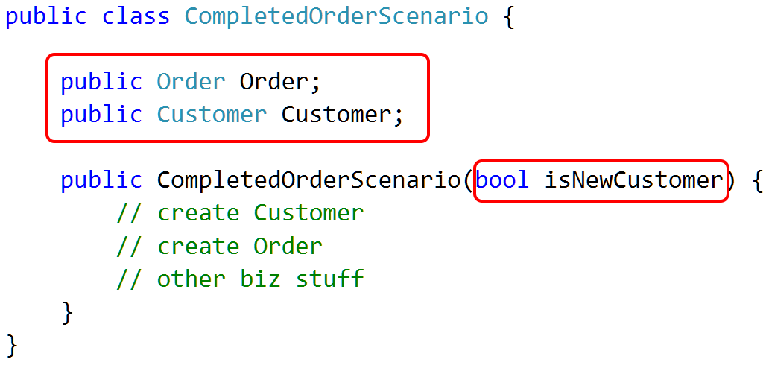
Key #3: Use Scenarios to reuse setup logic
Notes:
This is what the Scenario itself looks like. In the body of the constructor we create whatever data the scenario represents, and just like with Test Helpers you can allow the scenario to be customized via arguments.
Anything that the Scenario creates, and that a test might need to get a reference to, is exposed as class properties.
Sometimes, like you see here, the scenario is simple.

Slide 74
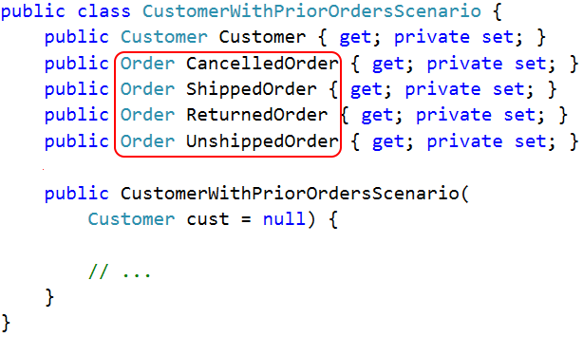
Key #3: Use Scenarios to reuse setup logic
Notes:
Here's a more complex example. In this case, we’re creating multiple orders for a single customer, each with different characteristics.
This sort of thing is especially helpful when you use it for integration tests because it's a super fast way to create a whole corpus of test data with just a few lines of code. We'll get to integration tests in just a moment.

Slide 75
Key #3: Use Scenarios to reuse setup logic
Drawbacks and warnings
Need balance between specialization & customization
Notes:
I recommend the Test Helper pattern without reservation. There’s literally no good argument not to. But there are a few drawbacks to the Scenario pattern that you should consider.
First, you’ll need to figure out for yourself the correct balance between specialization and customization. If you create a large number of Scenarios, each highly specialized for a specific use case, then you’ll generally find that each individual is scenario easy to maintain over time, but you’ll end up creating a lot of them with chunks of duplicate logic. If you create a smaller number of general purpose Scenarios that can be highly customized via arguments then you’ll create fewer objects, but it may be hard to refactor a Scenario because it might be used in lots of different ways by lots of different tests.
That balance is hard to predict in advance. My rule of thumb is that if I’m only creating two or three objects in a test, I’ll usually just call the Test Helpers directly. But if I have more than that, AND I’m reusing that logic in more than two or three tests, I’ll extract out a Scenario.

Slide 76
Key #3: Use Scenarios to reuse setup logic
Drawbacks and warnings
Need balance between specialization & customization
May indicate need for Façade pattern in core app
Notes:
Also, remember that Scenarios are helpful because they simplify the coordination of multiple related objects into a single abstraction. If you need a lot of Scenarios, that might be a code smell indicating that you should simplify your main application code instead.
For instance, in that e-commerce example I just showed you, I had to set up an Order, and Customer, and some Line Items, and I had to wire all that stuff together so that I could test code that deals with all of those objects. If I find myself doing that a lot, then maybe there’s the need for some kind of flattened, simplified “Order Summary” object in the main app.
And generally speaking, anything that you do to SIMPLIFY YOUR MAIN APP will also simplify your tests.

Slide 77
Key #3: Use Scenarios to reuse setup logic
Drawbacks and warnings
Need balance between specialization & customization
May indicate need for Façade pattern in core app
Complex code begets complex setup
Notes:
Also, remember that Scenarios are helpful because they simplify the coordination of multiple related objects into a single abstraction. If you need a lot of Scenarios, that might be a code smell indicating that you should simplify your main application code instead.
For instance, in that e-commerce example I just showed you, I had to set up an Order, and Customer, and some Line Items, and I had to wire all that stuff together so that I could test code that deals with all of those objects. If I find myself doing that a lot, then maybe there’s the need for some kind of flattened, simplified “Order Summary” object in the main app.
And generally speaking, anything that you do to SIMPLIFY YOUR MAIN APP will also simplify your tests.

Slide 78
Key Practice #4 Same helpers for unit and integration tests
Notes:
Until now we’ve been talking about in-memory objects only. The fourth key to effective setup is to leverage those in-memory helpers in your integration tests as well.
This is a key practice because it addresses mistake #4 that we talked about. If you have a library of helpers that create data, then your integration tests no longer need to rely on pre-existing data. Instead, they can create exactly what they need in exactly the shape they need it.
In a perfect world, we’d be able to use the same set of helpers to create data in memory or in the database.

Slide 79
Key #4: Integration tests
Foreign keys
Notes:
Unfortunately, that's easier said than done.
First, you have to deal with foreign keys. Your app may not care if you create a Line Item by itself, but you can’t save the Line Item to the database without an Order. And maybe you can’t create an Order without a customer. It’s the same issue we had with constructor dependencies, but in the database.
This means you have to new up the entire object graph and then save objects to the database in the correct sequence.

Slide 80
Key #4: Integration tests
Foreign keys
Primary keys
Notes:
And if your database assigns primary keys, then after you save all those objects you have to update their ID values with the newly assigned key.

Slide 81
Key #4: Integration tests
Foreign keys
Primary keys
Column constraints
Notes:
You also have to make sure that your helpers are creating data that can be saved. Some columns might have constraints that reject NULL or other values, and those constraints may not be duplicated in the domain model.

Slide 82
Key #4: Integration tests
Foreign keys
Primary keys
Column constraints
Junk data left behind by tests
Notes:
Lastly, you’ll want to clean up that test data when the test run is over. I run my automated tests against the same database I use for manual testing. I don’t want that database filled up with junk data because it can impact performance, waste disk space, and it’s just ugly.
These things make integration tests difficult, but we can handle them with a few extra additions to the Test Helper pattern.

Slide 83
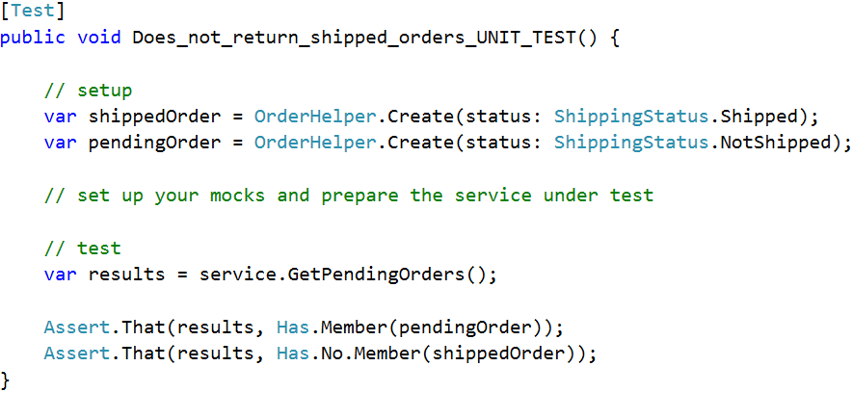
Key #4: Integration tests
Notes:
As an example, let’s start with this unit test. It creates two orders, sets up the service under test and prepares your mocks or stubs or whatever, and then asserts that the shipped order is NOT returned.
But if the service that we’re testing is a data service, then this filtering logic might be implemented in a SQL query. The only way to properly test that filter is to create real data in a real database.
But it would be great if we could use this same code to create that data in a way that addresses all of those issues we just looked at.

Slide 84
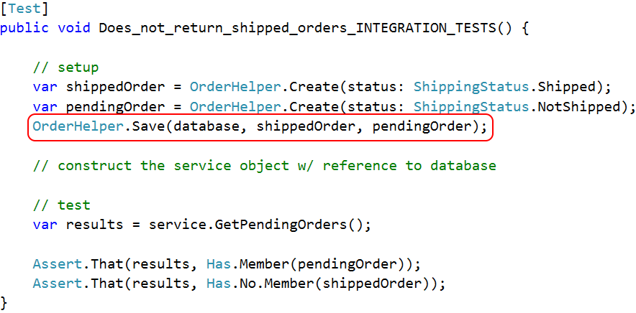
Key #4: Integration tests
Notes:
The first step to achieving that goal is to add a Save() method to your Test Helpers classes.
Obviously, this method needs some way of talking to the database, so you’ll either need to pass a database connection into the Save method when you call it, or you’ll need to use some sort of dependency injection to make it available. Since all of our other helper methods are static, I’ve found it easier to keep the Save method static as well and not worry about DI in this case.
My project uses NHibernate so we pass around an ISession right here. If you use Entity Framework then you might pass the db context here, or a raw ADO.NET connection or whatever other object that you need to talk to the database.

Slide 85
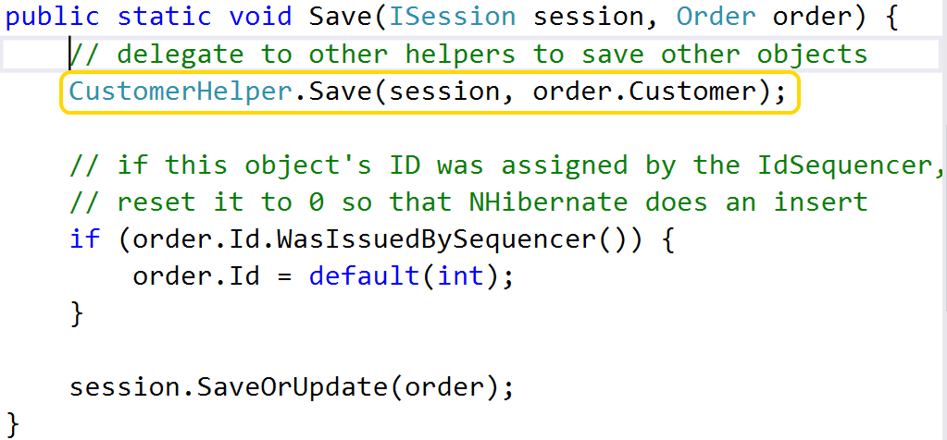
Key #4: Integration tests
Notes:
Here’s what the Save method itself looks like.
The first thing it does is deal with the foreign key constraints by delegating to other helpers to save its references. In this case, we can’t save an Order unless it references an existing Customer ID. By delegating to the Customer helper to create that record we keep each individual helper clean and focused on a single type.

Slide 86
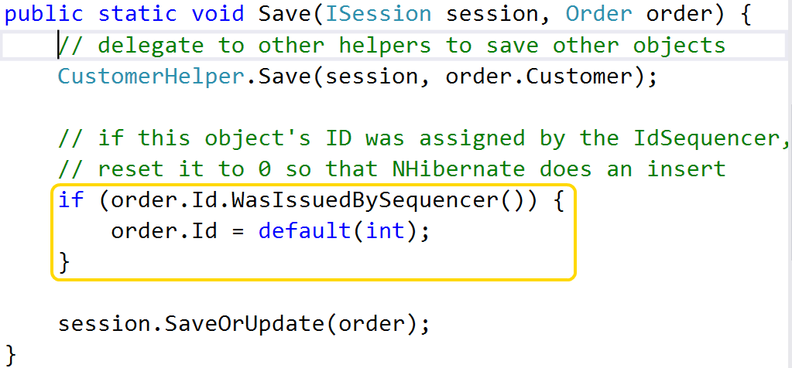
Key #4: Integration tests
Notes:
Next, the Save method deals with primary key values.
Remember that to avoid “unexpected equality”, each object that we create is assigned a non-zero value. But many ORMs use the ID property to determine if they should issue an INSERT or UPDATE query, and if the ORM sees a non-zero ID it will issue an UPDATE statement, and not an INSERT.
This is where that IdSequencer object comes in handy. It knows which values it’s handed out, so before we save our object we do a check to see if the ID currently in use was assigned by the sequencer. If it was then we reset it to 0, and cause an insert. If it wasn’t, then that means we’re dealing with an object that already exists in the database and we do nothing, and cause an update.
Note that we don’t need to reset ALL values that were assigned by the IdSequencer, only entity IDs. Only properties that map to primary keys.

Slide 87
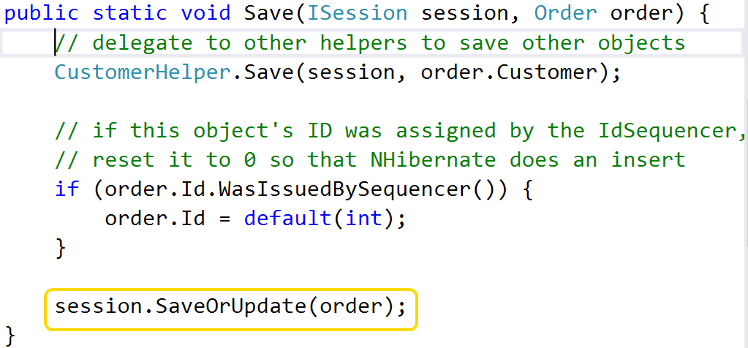
Key #4: Integration tests
Notes:
Finally, the helper calls out to the ORM to insert or update the database. If you’re not using an ORM then the exact details might change, but the general pattern should hold up.
If you follow this pattern then you can basically write a bunch of unit tests with in-memory data, copy and paste the setup code from one of them into an integration test, add a few calls to this Save method, and you’re done. It’s pretty sweet when it comes together.
But how do prevent this test data from lingering in the database when the test run is over?
One possibility is to reset the database to a known state at the start of each test run. This works, but I don’t recommend it. One reason is that it’s a massive pain to maintain that baseline backup every time the schema changes or new data is added. Another reason is that I use the same database for unit tests as I do for manual testing. It really sucks to spend a bunch of time crafting data for a manual test and then lose it because you accidently ran an integration test that wiped the slate clean.

Slide 88
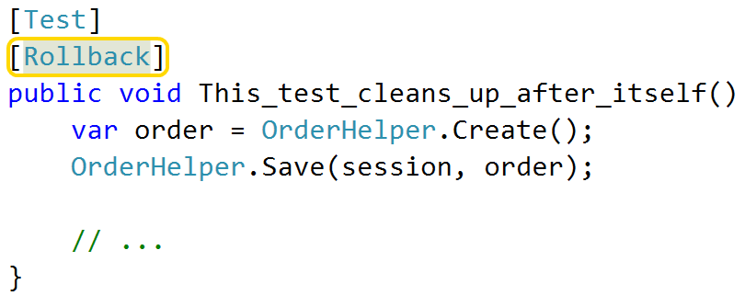
Key #4: Integration tests
[Rollback] attribute
Creates DB transaction when test starts
Rolls back when test ends
Notes:
Another option is to start a database transaction when each test starts, and then roll that transaction back when the test is over.
Years ago I wrote a custom NUnit attribute called Rollback that does this for us. Any test that has this attribute is automatically executed inside of a transaction that is discarded when the test finishes. The implementation for this is on my GitHub, but at this point it’s like seven years old. There are probably newer and better ways of doing it now, but you’re welcome to copy my approach if you’re using NUnit

Slide 89
Order brought to chaos
Notes:
As an example of how powerful these techniques can be, let’s first revisit that nasty chunk of setup code I showed at the start…

Slide 91
Notes:
All three screenfulls of it.

Slide 92
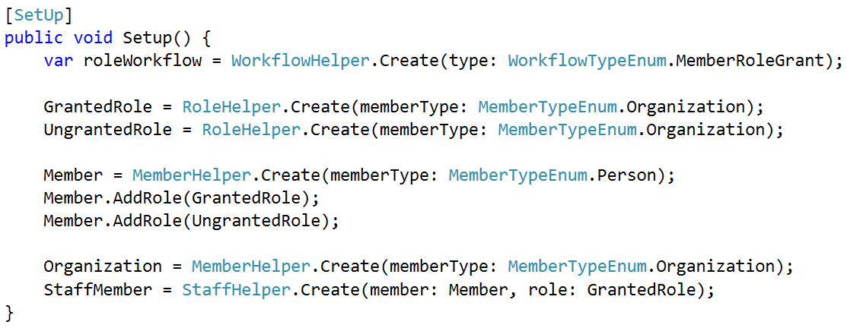
Order brought to chaos
Notes:
Here’s that same chunk of code, cleaned up and rewritten using Test Helpers. Most of the values and objects being created were irrelevant dependencies that didn’t impact the outcomes. After pushing all of that stuff into helpers, this is all that’s left and it’s way, way more readable.
I’ve said it before and I’ll say it again; the single most important thing you can do is build a good helper library and stop creating data by hand.

Slide 93
How to get started?
Start w/ simple objects first
Keep it clean / refactor as you go
No time like the present!
Notes:
To wrap up, I have some quick suggestions for how to get started with these patterns in your own code.
First, start by creating helpers for your simple objects first, the ones that don’t have lots of dependencies or child data. Then move up to more complex objects, delegating to the simple helpers as needed. If you try and start with that huge, massive, ancient beast that lives at the heart of your legacy system, it’s gonna hurt.
Second, continually refactor your helpers as needed. Remember that test code is “real code”; keep it clean and tidy just like you would anything else.
Lastly, the sooner you start implementing these patterns, the sooner you’ll notice the payoff. There is an investment to add these to a legacy system, but the promised land of clean, simple unit AND integration tests is totally worth it.

Slide 94
Patterns of Effective Test Setup
Stop creating objects by hand - use helpers
Tell a story – clear, concise, explicit
"Scenarios" for complex setup / for reuse
Same patterns for unit and integration tests
github.com/spetryjohnson | www.petry-johnson.com
@spetryjohnson
Notes:
And that brings us to the end of this session. Here are the 4 keys to effective test setup as well as links to these slides on Github, my website, and my twitter account. If you have any questions or comments I think we have a few minutes right now, or please feel free to seek me out online.
THANK YOU!

